Slide 1

AIIM Taxonomy Sample -2013-09-12

Slide 2
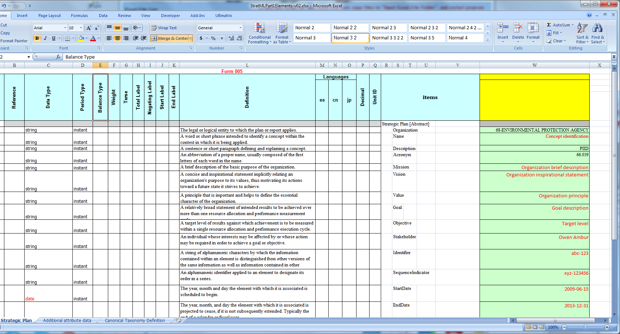
The RRD XBRL End-To-End Solution Offering
Data Standardization: Data Point Modeling to XBRL Taxonomy
1.1. Revision of Data Point Model provided by Owen Ambur, Chairman StratML CommitteeAIIM
Notes:
Development Cycle Time Frame:
1 day for a typical ARRA Form
1 Day for a typical ARRA Form (+ couple of days for specific Business Rules)
Run Time:
3) Real time Validation
4) Automated Data Storage into XBRL Database
5) Real Time Data Analytics

Slide 3
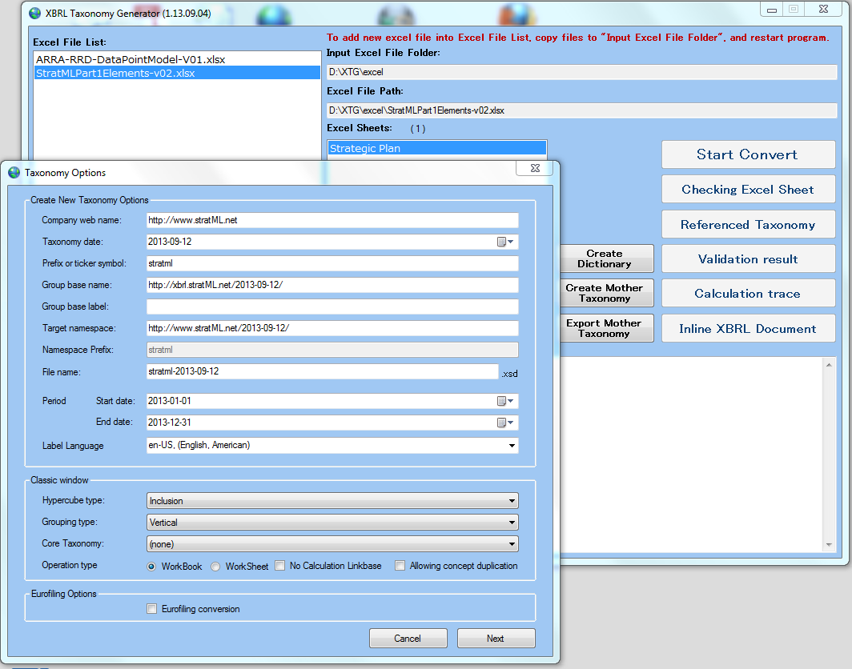
The RRD XBRL End-To-End Solution Offering
Data Standardization: Data Point Modeling to XBRL Taxonomy
1.2. XBRL Taxonomy Generator: Creation and Validation of Taxonomy & Instance test
Notes:
Development Cycle Time Frame:
1 day for a typical ARRA Form
1 Day for a typical ARRA Form (+ couple of days for specific Business Rules)
Run Time:
3) Real time Validation
4) Automated Data Storage into XBRL Database
5) Real Time Data Analytics

Slide 4
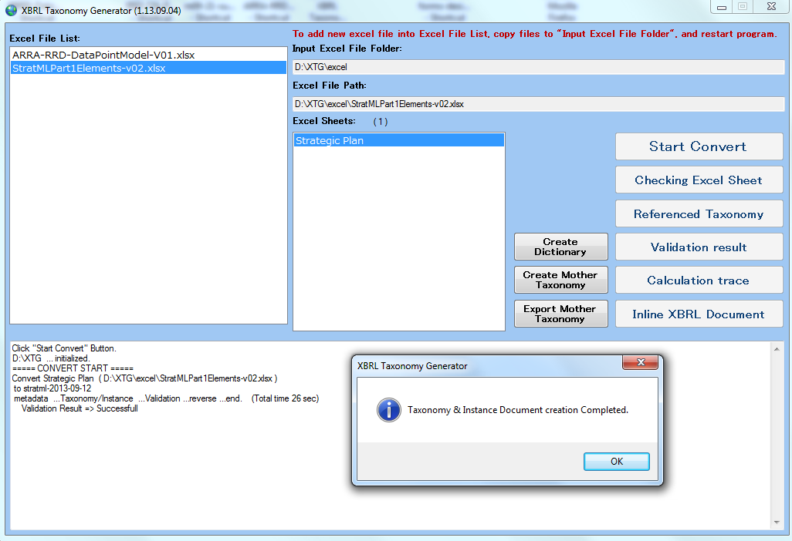
The RRD XBRL End-To-End Solution Offering
Data Standardization: Data Point Modeling to XBRL Taxonomy
1.3. XBRL Taxonomy Generator: Taxonomy & Instance test Created & Validated in 26 seconds
Notes:
Development Cycle Time Frame:
1 day for a typical ARRA Form
1 Day for a typical ARRA Form (+ couple of days for specific Business Rules)
Run Time:
3) Real time Validation
4) Automated Data Storage into XBRL Database
5) Real Time Data Analytics

Slide 5
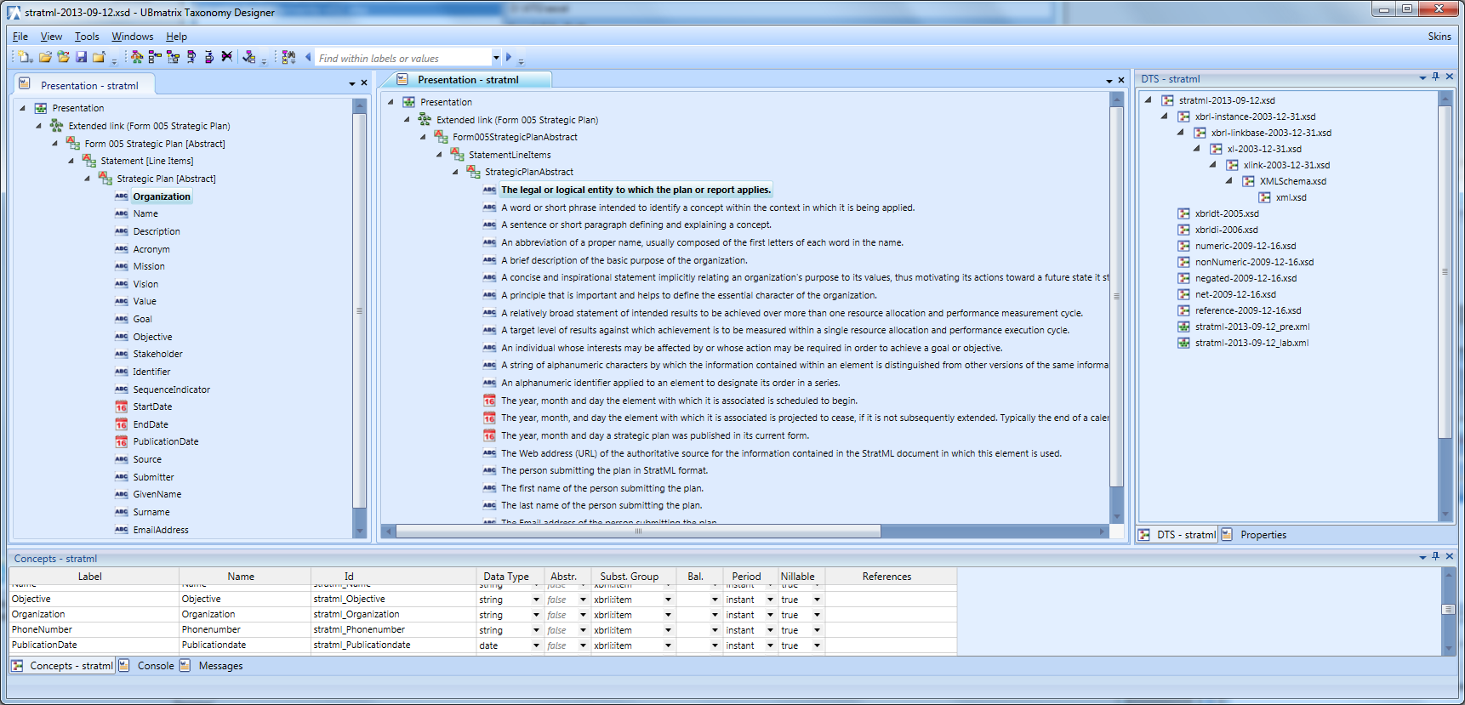
The RRD XBRL End-To-End Solution Offering
Data Standardization: Data Point Modeling to XBRL Taxonomy
1.4. Taxonomy Designer (TD7): View Taxonomy: Primary Items View and Documentation View
Notes:
Development Cycle Time Frame:
1 day for a typical ARRA Form
1 Day for a typical ARRA Form (+ couple of days for specific Business Rules)
Run Time:
3) Real time Validation
4) Automated Data Storage into XBRL Database
5) Real Time Data Analytics

Slide 6
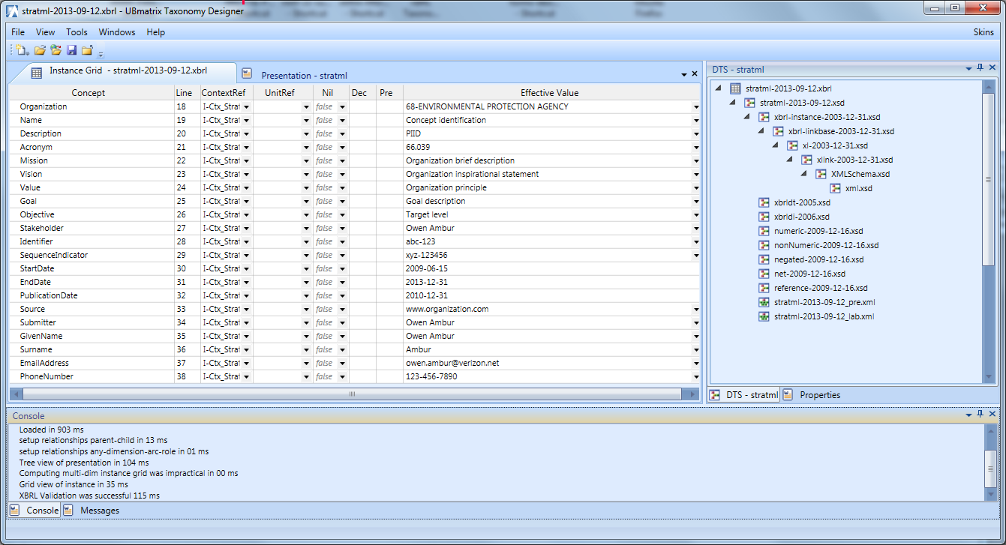
The RRD XBRL End-To-End Solution Offering
Data Standardization: Data Point Modeling to XBRL Taxonomy
1.5. Taxonomy Designer (TD7): View Instance Test
Notes:
Development Cycle Time Frame:
1 day for a typical ARRA Form
1 Day for a typical ARRA Form (+ couple of days for specific Business Rules)
Run Time:
3) Real time Validation
4) Automated Data Storage into XBRL Database
5) Real Time Data Analytics

Slide 7
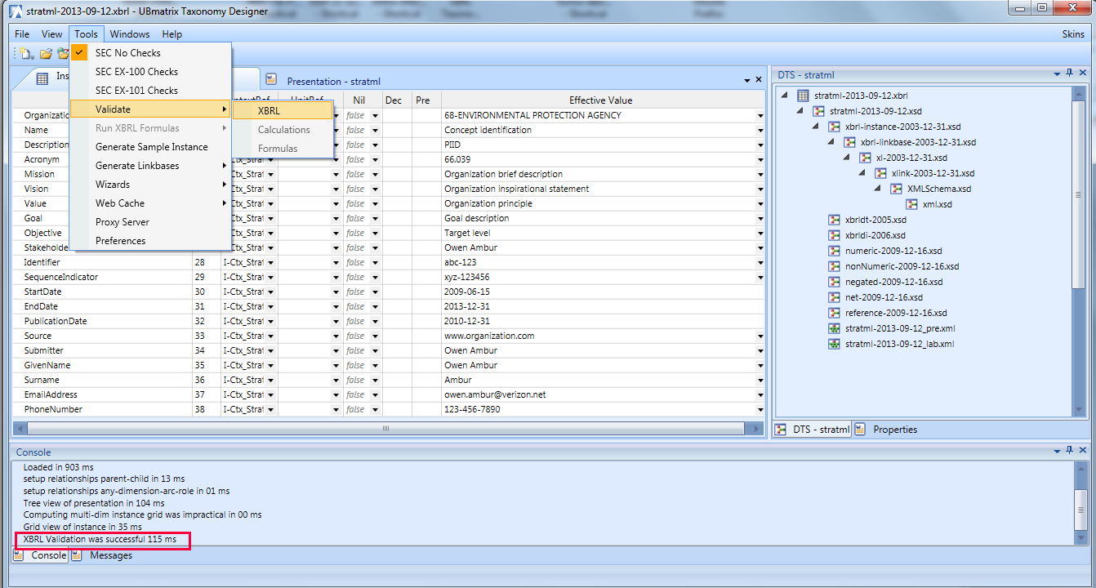
The RRD XBRL End-To-End Solution Offering
Data Standardization: Data Point Modeling to XBRL Taxonomy
1.6. Taxonomy Designer (TD7): Validation of Instance Test
Notes:
Development Cycle Time Frame:
1 day for a typical ARRA Form
1 Day for a typical ARRA Form (+ couple of days for specific Business Rules)
Run Time:
3) Real time Validation
4) Automated Data Storage into XBRL Database
5) Real Time Data Analytics

